Slide 1
Git It Together: “An Introduction to Version Control for Revit Users”
John Pierson
Design Technology Specialist
Parallax Team

Slide 2
git it together
“VERSION CONTROL FOR BEGINNERS”

Slide 3
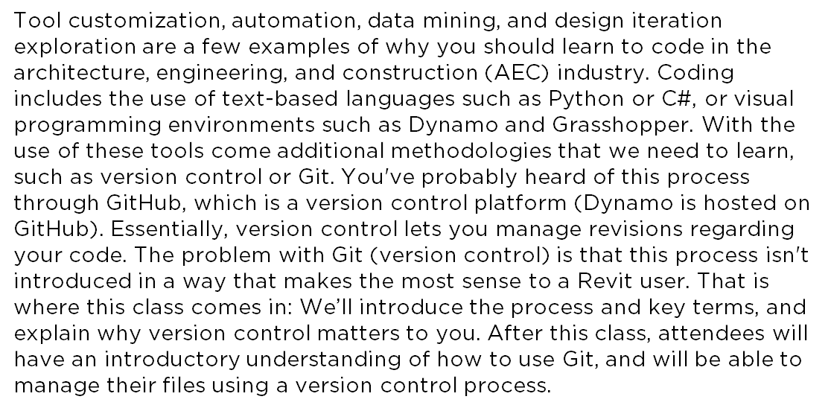
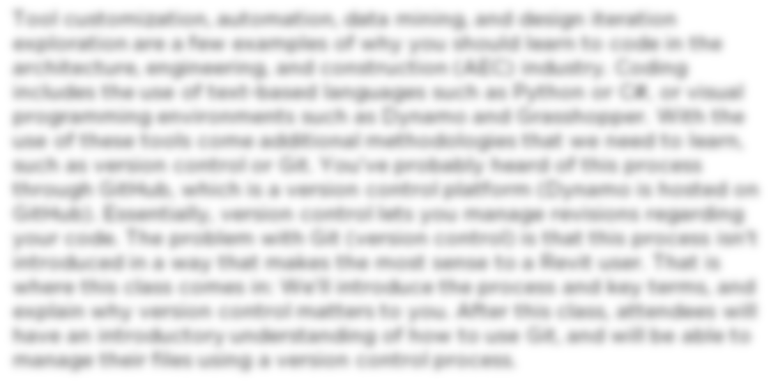
Summary
Essentially, version control lets you manage revisions regarding
your code.
We’ll introduce the process and key terms, and
explain why version control matters to you.

Slide 4
Learning Objectives
Gain an introductory understanding of version control processes.
Understand key Git terms.
Learn how to manage your files using version control.
Learn how to actively contribute to open-source projects.

Slide 5


Who?
Parallax Team is a Practice Implementation Consultancy specializing in BIM implementation, BIM Standardization, Computational Design, and pretty much anything AEC related.
www.parallaxteam.com | @prlxteam
Aaron Maller
Director
@twiceroadsfool
John Pierson
Design Technology Specialist
@60secondrevit

Slide 6

Who are you?
Image of an actual dynamo user trying to figure out if they are beginner, intermediate, or advanced.

Slide 7
What is Dynamo? (review)
Dynamo is not only a software, but also a community of awesome people doing awesome things.
Current Versions:
1.3.3 & 2.01 – Revit 2017 – 2019
For supported versions for older Revit versions refer to http://dynamoprimer.com/en/08_Dynamo-for-Revit/8-1_The-Revit-Connection.html

Slide 8
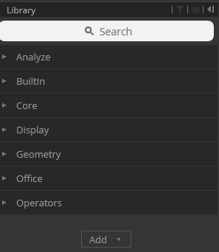
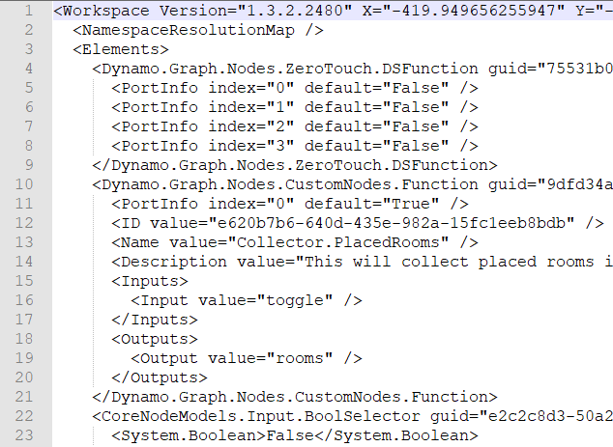
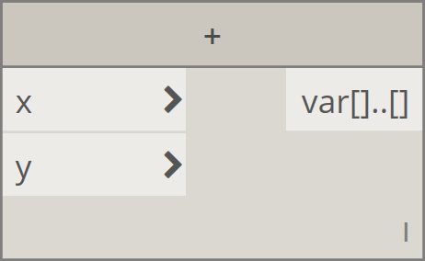
Version Differences - 1.3.3
Same library for several years.
Packages bundled within the library categories
Node in Dynamo 1.3.3
XML-Based file format
Note the “<>”

Slide 9
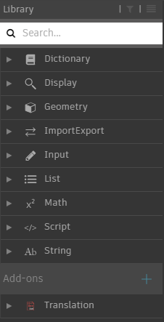
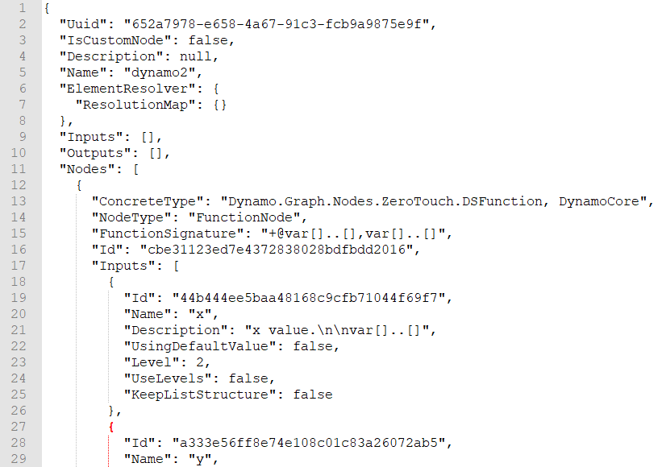
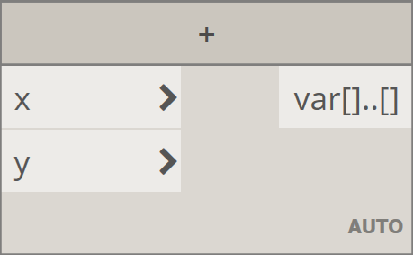
Version Differences – 2.0.x
New Appearance
Add-ons category for custom packages
Node in Dynamo 2.0.x
Auto-Lacing by default
JSON-Based file format
Note the “{}”

Slide 10
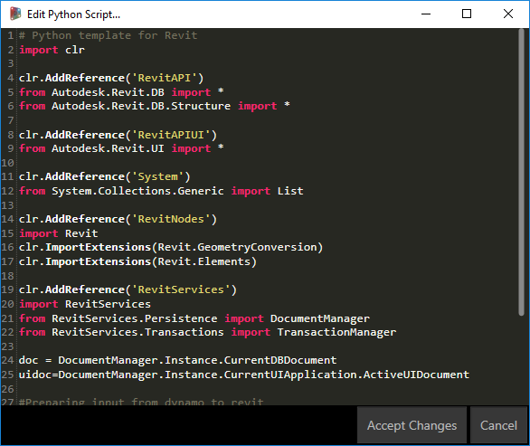
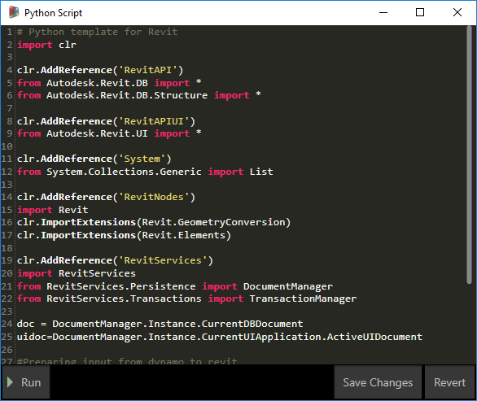
But, most important (for this class)
Python Editor in 1.3.3 and prior
No support for templates
Modal Window – Meaning you cannot work outside of it
Python Editor in Dynamo 2.0.x
Support for templates! (thanks Radu) http://primer.dynamobim.org/en/10_Custom-Nodes/10-6_Python-Templates.html
Allows “on-the-fly” execution of Python Scripts.
Allows for multiple Python windows
Edit and run graph with window open

Slide 11
What is Python?
Python is an open-source, general-purpose programming language.
Does not require compiling to be tested.
Provides quick “try it out, see what it does” gratification.
Revit Comparison: Similar to editing families, loading into project for testing, repeat.

Slide 12
What is Iron Python?
A version of Python that is created in C#.
Allows for use of the Common Language Runtime to talk to other .NET applications/libraries. (http://ironpython.net/)
Version 2.7 Installed alongside Dynamo.

Slide 13


Let’s do this
Walk
Opening Python
Key Terms + Syntax
Variables
Changing single item
Jog
Variables
Working with Lists
Output Methods
Templates
Run
Reference Revit API
API Methods
Wrap/Unwrap
Templates

Slide 14
Anatomy of Python Window
# Enable Python support and load DesignScript library import clr clr.AddReference('ProtoGeometry') from Autodesk.DesignScript.Geometry import * # The inputs to this node will be stored as a list in the IN variables. dataEnteringNode = IN # Place your code below this line # Assign your output to the OUT variable. OUT = 0
Notes are designated with pound “#” sign
These are the OOTB included imports (more on this later)
General information regarding how to get data in. *The existence of the variable is to let you know that the inputs are all a list.
Return something
*https://twitter.com/arch_laboratory/status/954398424039854080

Slide 15
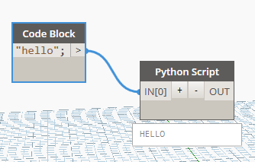
Example Uppercase Strings
Access Python methods for our use. (https://www.tutorialspoint.com/python/string_upper.htm)
Use Python inputs via IN[0] or whatever it is.
# Enable Python support and load DesignScript library import clr clr.AddReference('ProtoGeometry') from Autodesk.DesignScript.Geometry import * # The inputs to this node will be stored as a list in the IN variables. dataEnteringNode = IN # Place your code below this line # Assign your output to the OUT variable. OUT = IN[0].upper()
Why the “()”? – this is a function(action) in python, and well, it showed it in the link above, so do it.

Slide 16
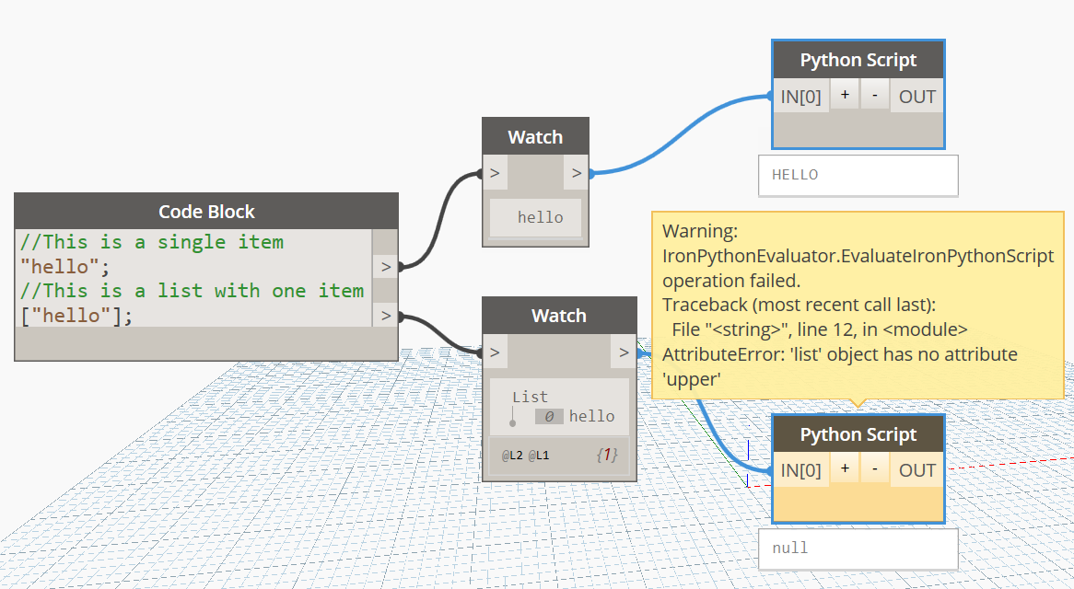
Example Working with Lists

Slide 17


Example Uppercase Strings
What is your name?

Slide 18
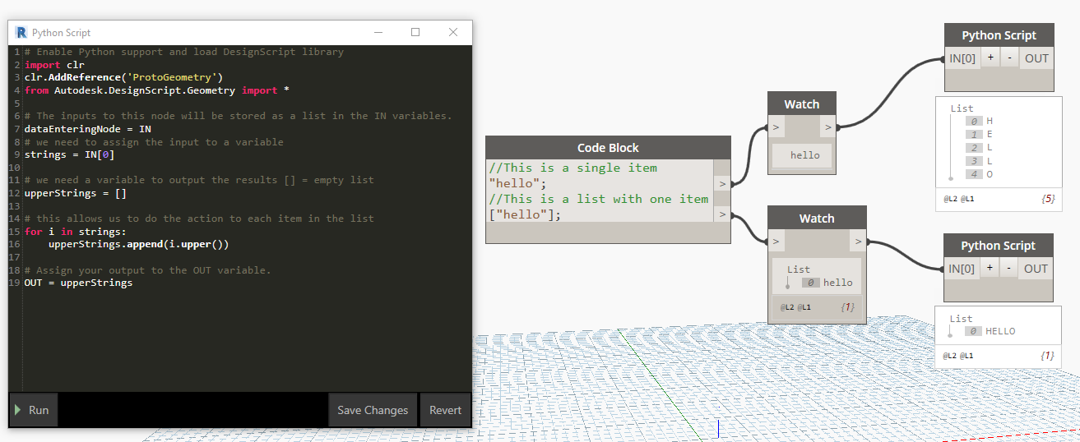
Example Uppercase List of Strings
Notes:
# Enable Python support and load DesignScript library import clr clr.AddReference('ProtoGeometry') from Autodesk.DesignScript.Geometry import * # The inputs to this node will be stored as a list in the IN variables. dataEnteringNode = IN # we need to assign the input to a variable strings = IN[0] # we need a variable to output the results [] = empty list upperStrings = [] # this allows us to do the action to each item in the list for i in strings: upperStrings.append(i.upper()) # Assign your output to the OUT variable. OUT = upperStrings

Slide 19
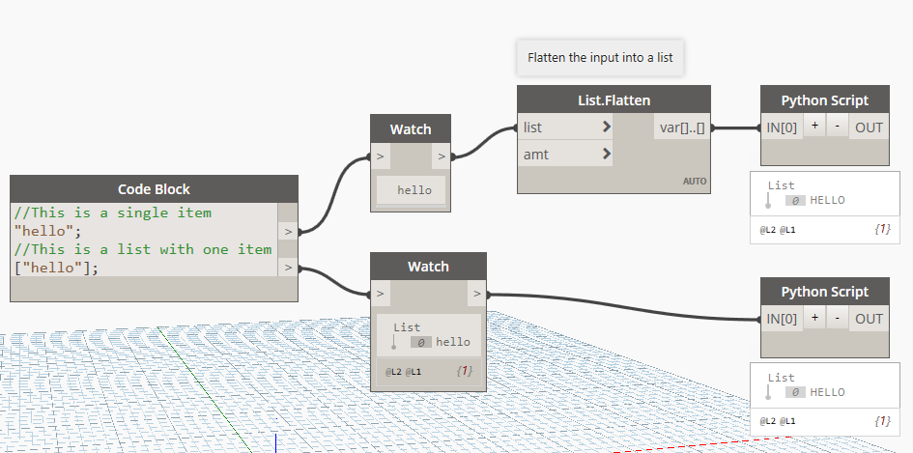
Example Uppercase List of Strings
Work with an assumption of receiving a list.
Convert the input to a list yourself.

Slide 20
well.
THAT WASN’T SO BAD. RIGHT?

Slide 21
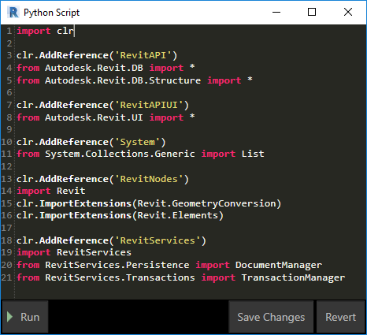
What in the heck are Imports?
Imports are a way to load additional libraries into your code.
For us Reviteers, we can think of this as the same as loading content into a file.
Next we will break down what these mean.

Slide 22
Breaking Down Imports
# import common language runtime (allows us to load other .NET libraries) import clr # clr.AddReference loads and imports .net assembly(dll) as python module and import all of its classes clr.AddReference('RevitAPI') from Autodesk.Revit.DB import * # import Revit UI classes clr.AddReference('RevitAPIUI') from Autodesk.Revit.UI import * # to handle lists clr.AddReference('System') from System.Collections.Generic import List # import Dynamo Revit nodes and converters clr.AddReference('RevitNodes') import Revit clr.ImportExtensions(Revit.GeometryConversion) clr.ImportExtensions(Revit.Elements) # import Transaction methods and Document helpers clr.AddReference('RevitServices') import RevitServices from RevitServices.Persistence import DocumentManager from RevitServices.Transactions import TransactionManager

Slide 23

Transactions?
Charlie knows about transactions!
Notes:
Transactions?
Transactions can be conceptualized in the same manner that they obtain their namesake from. Think about buying a candy bar at a candy store. For you to obtain the candy bar, you need to start a transaction with the cashier. Within that transaction certain things take place. This includes, finding out the total cost, handing over the money, ringing up the item and closing out the sale. The same thing goes for Revit. We start the transaction, do some things and apply the changes to the Revit model. Note: A transaction in Dynamo will almost always result in having an undo available in Revit.

Slide 24
Do I have to memorize that?
Heck no.
Template provided that covers most of your Dynamo Revit workflows.
Auto load on new Python script placement.

Slide 25
Python Template in Dynamo
Adding templates to get going faster.
http://dynamoprimer.com/en/10_Custom-Nodes/10-6_Python-Templates.html
To get the path quickly use, AS224711-00-GetCurrentUserPythonTemplatePath_end.dyn in the dataset

Slide 26

I wish Dynamo had a node for [blank].
First, check if it is possible in the Revit API with API Docs by Gui Talarico.

Slide 27
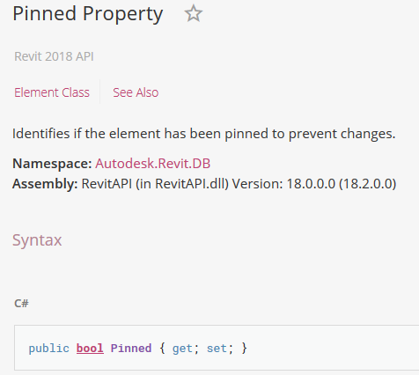
Revit Example Element Pinned
API Docs returns the following
This is a property on an element of type, Autodesk.Revit.DB.Element
This means that we need to convert the selected element to an internal version.
{ get; set} means that we can query the value or change it.

Slide 28


Wrapped versus Unwrapped
Tortilla
Toasted
Warm
More Inside?
Rice
Tomatoes
Cheese
Steak
Guac
Etc.

Slide 29
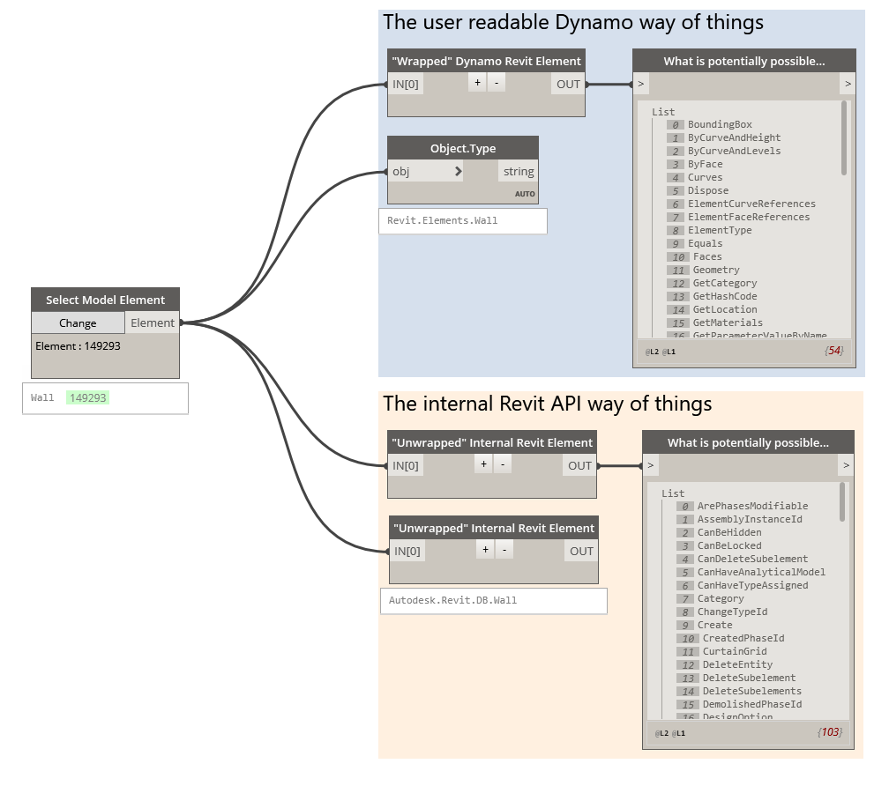
Wrapped versus Unwrapped

Slide 30
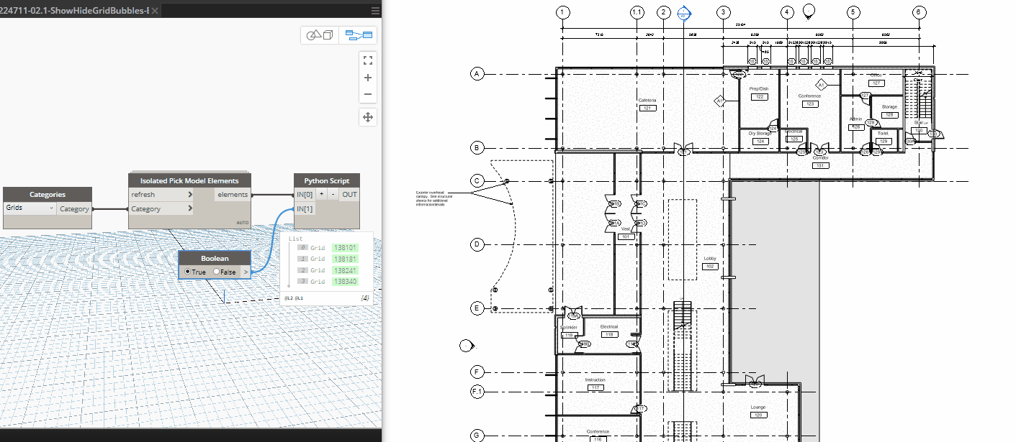
Revit Example Show Grid Bubbles

Slide 31
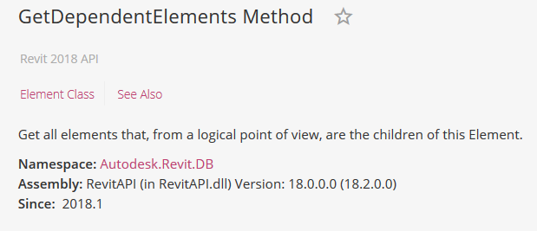
Revit Example Find Doors in Walls
With Revit 2018.1, we were given the ability to find out what elements are dependent on another.
Lets build a node to implement this.

Slide 32
thank you.
NOW, GO DO GREAT DYNAMO THINGS
@prlxteam | @twiceroadsfool | @60secondrevit

Slide 33
Autodesk and the Autodesk logo are registered trademarks or trademarks of Autodesk, Inc., and/or its subsidiaries and/or affiliates in the USA and/or other countries. All other brand names, product names, or trademarks belong to their respective holders. Autodesk reserves the right to alter product and services offerings, and specifications and pricing at any time without notice, and is not responsible for typographical or graphical errors that may appear in this document.
© 2018 Autodesk. All rights reserved.

Slide 34
Simplifying Dynamo Graphs
Python is great for condensing portions of your Dynamo graph into single nodes. Since we can use the built-in Dynamo Revit methods, we can do awesome things.

